Slide 1
Food Distribution Program
WBSCM Requisitions: Part II
Texas Department of Agriculture
USDA Division

Slide 2
Why WBSCM?
The FDP Module in TX-UNPS does not have an upgrade.
Since 2010, TDA has used the Web Based Supply Chain Management System (WBSCM) to submit RA orders to USDA.
USDA owns and regularly upgrades WBSCM, making it the best solution to serve RAs in Texas now and in the future.
Notes:
Review information on slide with RAs. If presenting on same day as RA103 Part II, ESCs can hide this slide

Slide 3
Acknowledgement Statement
You understand and acknowledge that:
The training you are about to take does not cover the entire scope of the program; and that
You are responsible for knowing and understanding all handbooks, manuals, alerts, notices, and guidance, as well as any other forms of communication that provide further guidance, clarification, or instruction on operating the program.

Slide 4
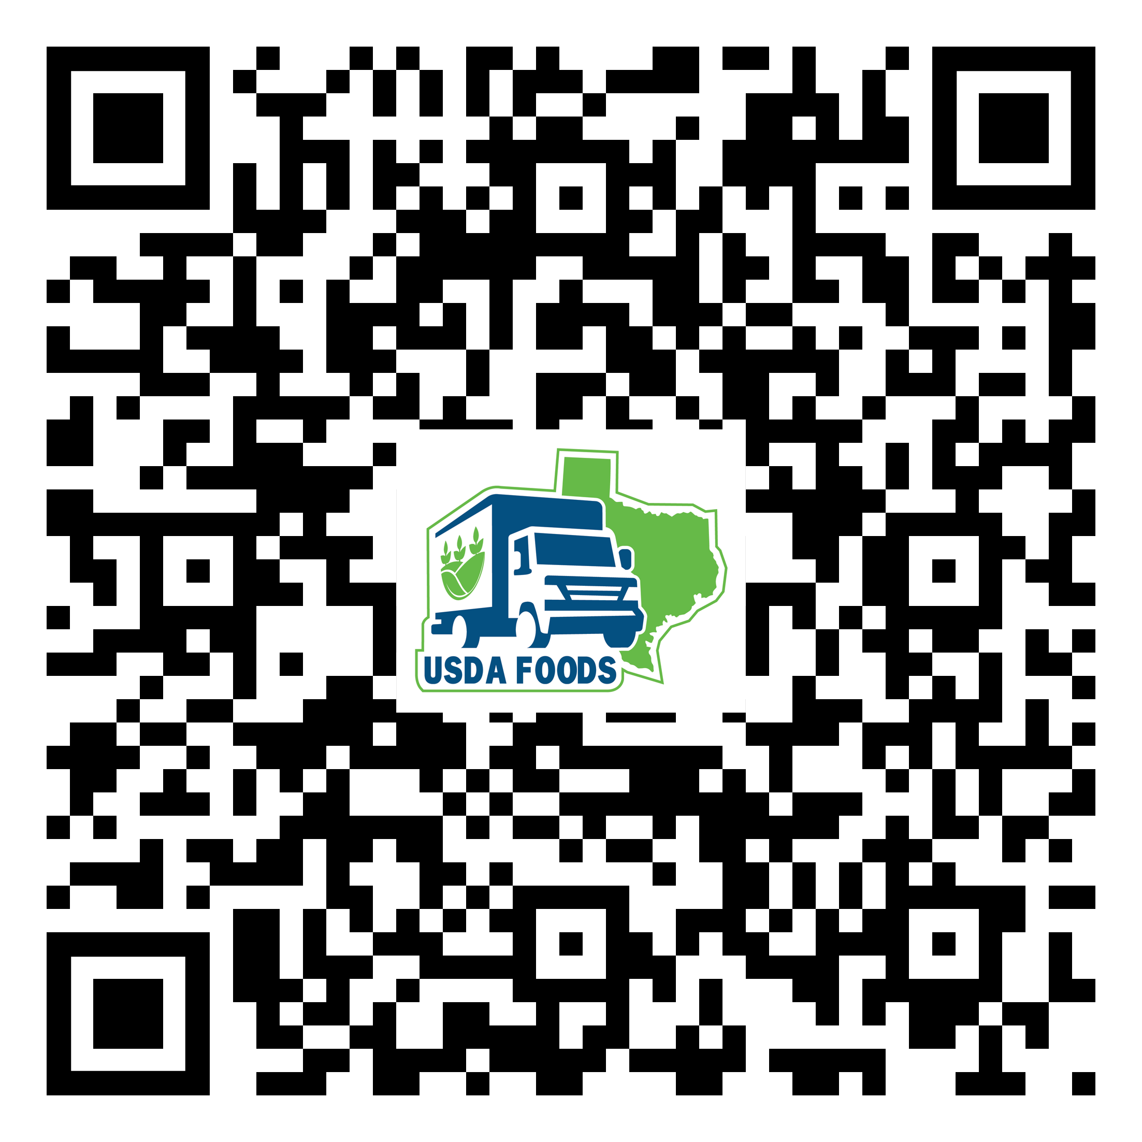
WBSCM Transition Page QR Code:
Scan QR Code to visit the Food Distribution Program WBSCM Transition website

Slide 5
01
Course Introduction
Course Outline and Objectives

Slide 6
01
Introduction
Course Overview and Objectives
02
Fulfillment Overview
Understanding process, requisition related terms and definitions
03
03
Processing Diversion via Extended Search
Processing Diversion: Selecting products and Deliver To/Ship-To’s using Extended Search; submitting requests.
WBSCM Requisitions Part III
Course Outline

Slide 7
Course Objectives and Outcomes
By the end of this course, participants will be able to:
Understand WBSCM Requisition Terminology and Acronyms
Understand how to create a Processing Diversion requisition via Extended Search for items to be ordered (including quantities, delivery location, and delivery dates).

Slide 8
02
Fulfillment Overview

Slide 9
High Level Fulfillment Process
TDA
Distributes
Entitlement
RA
Submits
Requisition
(Req #)
TDA
Creates
Sales Order
USDA
Approves
Sales Order
(SO # Created)
Vendor
Fulfills SO
(PO # Created)
Goods
Delivered to /
Processor
(Receipting)
WBSCM only has visibility from Entitlement to Initial Delivery Point
Notes:
NOTE: Initial delivery point for processing diversion commodities is bid-awarded, state-approved processors. RAs will use processor tracking system when materials requested in WBSCM arrive at the designated Ship-To/initial delivery point.

Slide 10
TX-UNPS vs. WBSCM Terms and Definitions
TX-UNPS | WBSCM | Definition
 | Requisition | Pre-cursor to a sales order. RAs create a requisition when they wish to order goods in WBSCM.
Surveys | Catalog | Formerly known as surveys. Medium used to organize material or product to place requisitions in WBSCM.
Delivery Order | Sales Order | Formerly known as delivery orders. Orders created by TDA to indicate sale of products. SO (Sales Order) created after requisitions have been created, submitted, consolidated, and approved and before item goes to procurement for sourcing. This is done before the creation of a purchase requisition (PR).
Notes:
Review information on slide with RAs

Slide 11
03
Processing Diversion Requests:
Extended Search

Slide 12
Training Portal Log-In
ESCs and RA Users Log In To WBSCM Training Environment
Login Required To Complete Assessment Questions URL: wbscmntrn.wbscm.usda.gov
RA Training Environment Username and Password previously provided via e-mail.
Note the "ntrn" section of web address
This indicates the training environment
Notes:
Highlight the difference between training environment vs. Production URLs.
Production environment does not have the "ntrn" component in the web address.
Logins previously provided via to RAs for training environment
Log in to training environment will be different from login to username for live system which occurs after all required training is complete.

Slide 13
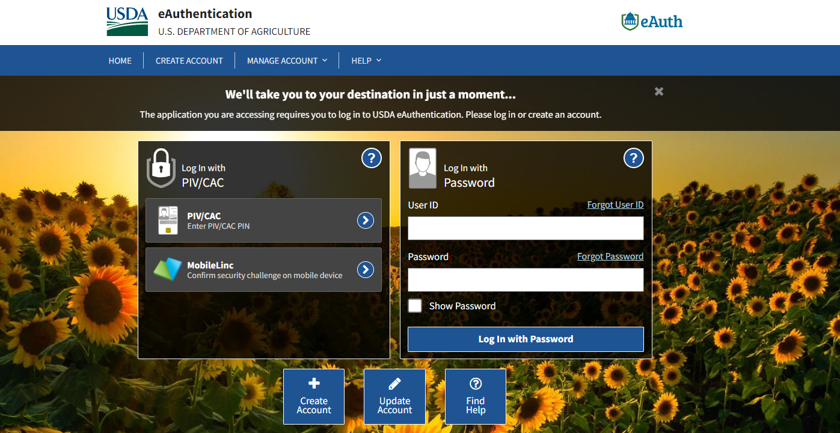
Log On To WBSCM Training Environment
Enter Training User Login
Training Environment Login Page looks identical to Live Production Login Page.
Bookmark training environment link to minimize login errors.
traininguserinfo@training.org
assigned.training.password
Enter training password
Click log in button
Notes:
TRAINER NOTE:
Training Environment and Live Production Log In Page will look the same.
If not completed in RA101, Bookmark training environment which includes “ntrn” in the URL.
Training environment logins will include no personal user information.
Each ESC region assigned their own set of training logins to distribute between RAs
The next slides will be a review of WBSCM RA view and reminder to check for new content. Will be particularly helpful for those conducing training over multiple weeks.

Slide 14
Training Environment Log-In
RA Training Environment View
NTRN icon signals training environment.
User and Organization Name
ESC Training Environment View
NTRN icon signals training environment.
User and Organization Name
Notes:
User name and organization will show different user roles. Differences in navigation panels will be determined based on roles/level of access. Let participants know what NTRN stands for. (Training Environment)

Slide 15
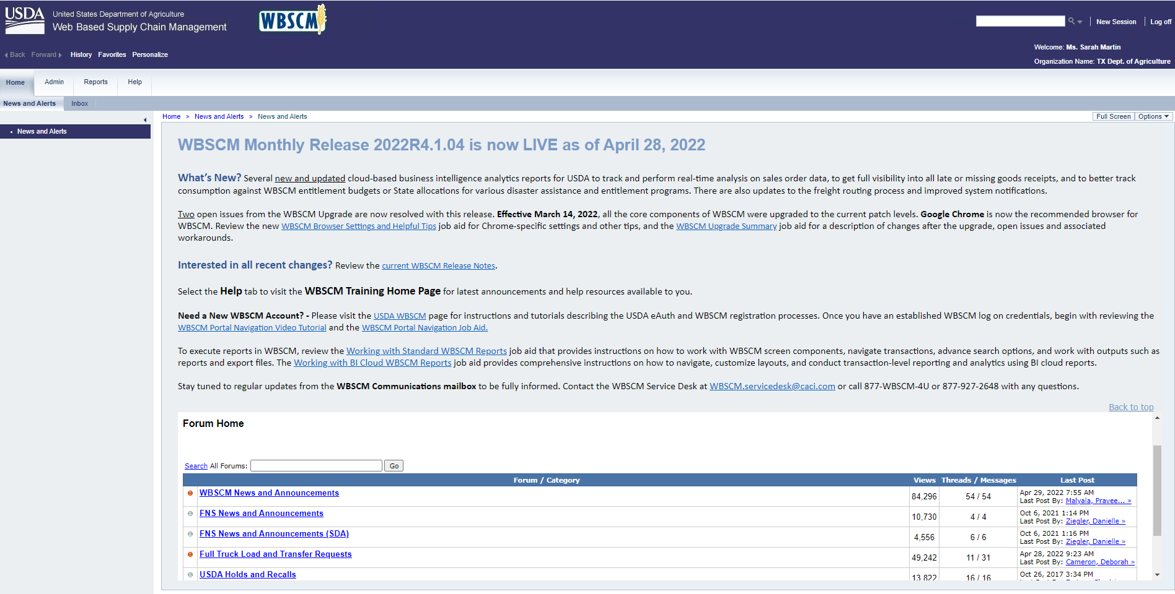
Check for New Content
Check Forum for updates.
Notes:
Review importance of checking forum for updates/announcements when they have access to Live Production environment (for Pilot RAs=Jan 2023, for state-wide RAs=Jan 2024)

Slide 16
Locate specific product by product number.
Create A New Requisition for Each Ship-To Location
Example:
Request #1 → Processing Ship To Location #1
Request #2 → Processing Ship To Location #2
Request #3 → Processing Ship To Location #3
Locate specific product by product number.
Notes:
Review information on slide with RAs

Slide 17
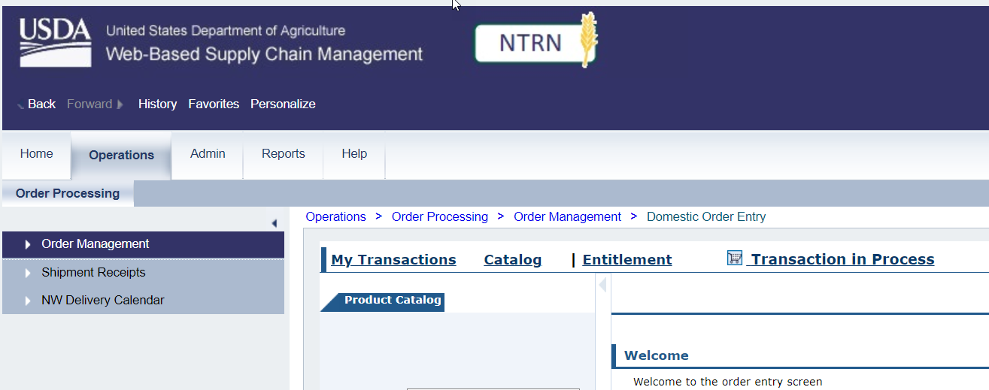
Processing via Extended Search
1
Click On Operations
Click On Order Management
2
Notes:
Follow the next set of steps on each slide to request Processing Diversion via Extended Search .
Order Managers will select the Operations module tab, then select Order Management from the Navigation Panel

Slide 18
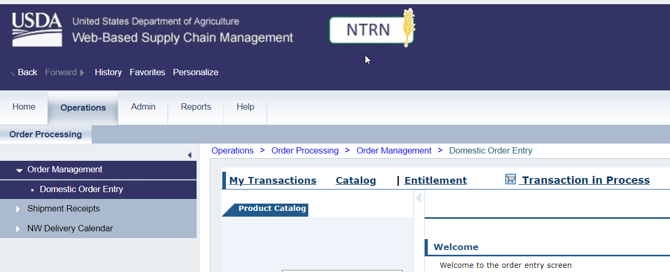
Processing via Extended Search
*Note: This part of the process is a request for materials. This is not an order submission.
Click On Domestic Order Entry
Notes:
NOTE: The Product Catalog Screen may auto-populate.
Click on Domestic Order Entry
At this point of the fulfillment process, RAs will request their foods to be delivered to their desired Ship-To destination of their state-approved, bid-awarded, selected Processor for Processing Diversion requests. TDA will submit those requests to USDA on their behalf.

Slide 19
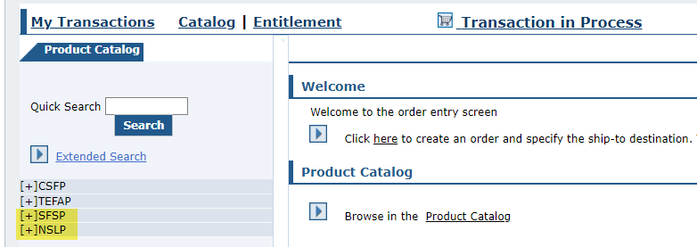
Domestic Order Entry Screen
Main Content Area Showcasing Domestic Order Entry Screen
Programs will appear on Panel but will not be needed for Extended Search
Notes:
RAs will not need to select programs when creating requisition via Extended Search.
NOTE: Remind users that this is not an ORDER despite the name of the entry screen. This is a REQUISITION for TDA to order on behalf of RAs/CEs.

Slide 20
Domestic Order Entry Screen
Hide Nav. Panel by clicking arrow
Notes:
To enlarge main content area, hide navigation panel by clicking arrow.

Slide 21
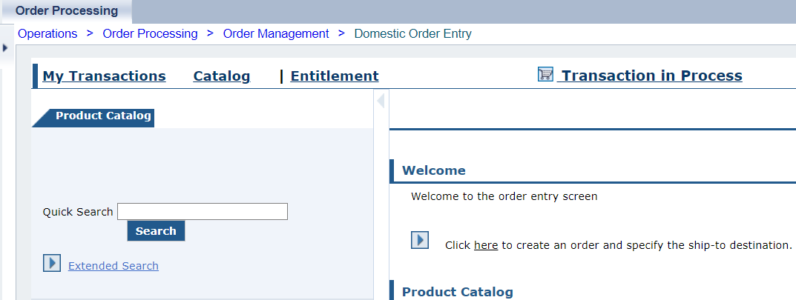
Domestic Order Entry Screen
Domestic Order Entry Screen with Navigation Panel hidden.
Notes:
NOTE: Remind users that this is not an ORDER despite the name of the entry screen. This is a REQUISITION for SDA to order on behalf of CEs.

Slide 22
Processing Diversion via
Extended Search
User needs to locate available products in catalog for requisition.
Browse catalog for available products.
Locate specific Processing Diversion product via product number.
Notes:
Review information on slide with RAs

Slide 23
Processing Diversion via Extended Search
Not all processors receive all material/product numbers
Requesting processing items via catalog increases the risk of sending materials to the wrong processor
Requests for materials sent to the wrong processors will be cancelled
Use Extended Search to locate materials your bid-awarded processor can receive at their facility
CAUTION
Notes:
During the pilot, RAs who ordered processing items via catalog had a high proportion of materials sent to the wrong processor.
Those requests were cancelled and RAs were unable to make corrections or submit new requests to the correct processors

Slide 24
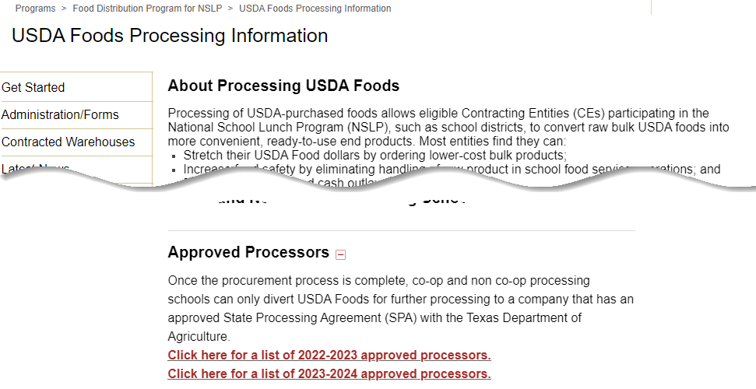
Locate List of Approved Processors
1
Go to USDA Foods Processing Information page on SquareMeals
Scroll to “Approved Processors” section
2
Open list of approved processors
3
Locate specific product by product number.
Notes:
Before choosing materials to search for via Extended Search, reference the list of approved processors sheet found on the USDA Foods Processing Information page on SquareMeals (hyperlinked in slide—scroll down to Approved Processors section) to find material/product codes to send to bid-awarded processors.
https://squaremeals.org/Programs/Food-Distribution-Program-for-NSLP/USDA-Foods-Processing-Information

Slide 25
List of Approved Processors
EXAMPLE:
Foster Farms used as bid-awarded processor
Find Material/Product Number accepted by your bid-awarded processor for further processing
1
2
Find your bid-awarded processor
Locate specific product by product number.
Notes:
Find RA bid-awarded processor on spreadsheet
Locate product numbers accepted by bid-awarded processors.
Use these numbers to request via “Extended Search” (See next slides for directions)
NOTE: In this example, Foster Farms is used as the bid-awarded processor accepting material/product number 100103.
The LOM (Processing Tab) on this spreadsheet lists material descriptions for each material/product number.
Examples for extended search in the next slides will use 100103 Chicken Large Chilled Bulk

Slide 26
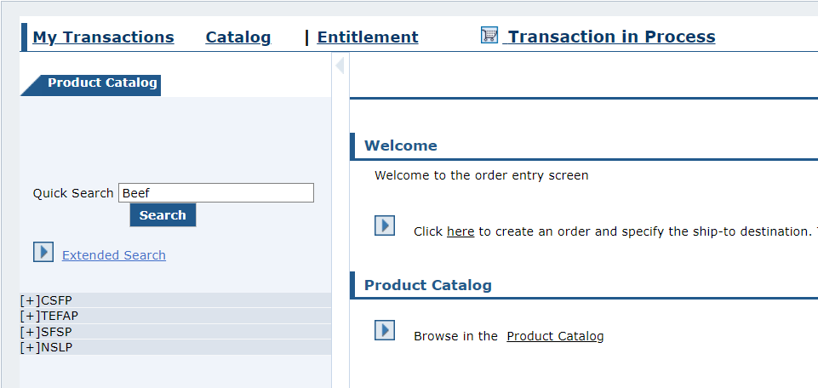
Processing via Extended Search
Click on “Extended Search”
3
Locate specific product by product number.
Notes:
RAs will use Extended Search to search processing items via material/product number from list of approved processors
Click on Extended Search to enter material/product numbers

Slide 27
Processing via Extended Search
4
Enter Product Number
REMINDER:
Use “List of Approved Processors” document to locate product numbers available for further processing by your bid-awarded processor.
Locate specific product by product number.
Notes:
Reference the List of Approved Processors Sheet found on the USDA Foods Processing Information page on SquareMeals (linked in slide).
RAs should confirm the material code is accepted by their bid-awarded processor
Enter the product number in the Product Number field https://squaremeals.org/Programs/Food-Distribution-Program-for-NSLP/USDA-Foods-Processing-Information

Slide 28
Processing via Extended Search
5
Click “Search”
Locate specific product by product number.
Notes:
Click Search to locate material
Reminder:
Reference the List of Approved Processors Sheet found on the USDA Foods Processing Information page on SquareMeals. https://squaremeals.org/Programs/Food-Distribution-Program-for-NSLP/USDA-Foods-Processing-Information

Slide 29
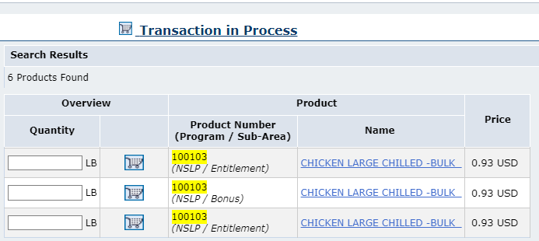
Processing via Extended Search
Confirm Program and Sub Area (NSLP, Entitlement, Bonus, etc.) before selecting line item.
6
Locate specific product by product number.
Notes:
(Note) Search results may include different programs and options. Refer to the Product Number (Program / Sub-Area) column to select materials for the appropriate program when identifying which product(s) to order.

Slide 30
Processing via Extended Search
Quantity Column
Note the UoM (Unit of Measure) when entering quantities.
Example: LB (pounds)
Locate specific product by product number.
Notes:
Emphasize importance of reviewing and confirming unit of measure

Slide 31
Processing via Extended Search
Product Name Column
Lists product/material name and details
Locate specific product by product number.
Notes:
The next slides will review each column with descriptive information for each column.

Slide 32
Processing via Extended Search
Price Column
Lists product material price per UoM (Unit of Measure in Cases or Lbs.).
Locate specific product by product number.
Notes:
Review information on slide with RAs

Slide 33
Processing via Extended Search
Do not enter a value in Quantity field.
Leave blank
Locate specific product by product number.
Notes:
Review information on slide with RAs

Slide 34
Processing via Extended Search
Click Shopping Cart icon next to desired product to view details and available delivery dates
Click here
Locate specific product by product number.
Notes:
Review information on slide with RAs

Slide 35
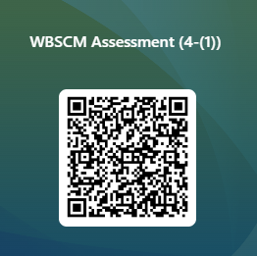
RA-Assessment:
Scan QR Code to access the assessment or click/type in the link below in your browser.
https://forms.office.com/r/DdcmVGMDQS
Notes:
RAs should complete this assessment question as part of required training.
RAs can access the question and select the appropriate response by using devices to access the QR code or by using the link on the slide.

Slide 36
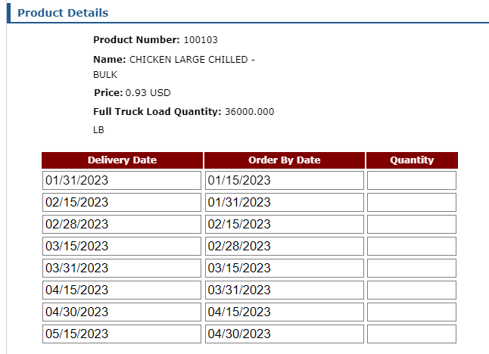
Processing via Extended Search
Product Details
Scroll if needed to see all available dates
Locate specific product by product number.
Notes:
Product details is an at a glance way for someone to factor what they are ordering. RAs can select multiple delivery dates to the RA selected Ship-To (Processor for Processing Diversion requests)

Slide 37
Processing via Extended Search
Delivery Date
Range of dates when commodities may be delivered to selected Deliver To/Ship-To destination (Processor for Processing Diversion).
Pre-populated/not editable.
Locate specific product by product number.
Notes:
Delivered to Ship-To Destination (Processor for Processing Diversion requests)
These dates are not editable.
RAs should spread out their processing diversion requests and delivery dates throughout the year.

Slide 38
Processing via Extended Search
Order By Date
Last date to submit request for the corresponding Delivery Date.
Pre-populated/not editable.
Locate specific product by product number.
Notes:
This column lets RAs know the date materials should be ordered to meet the corresponding desired delivery date

Slide 39
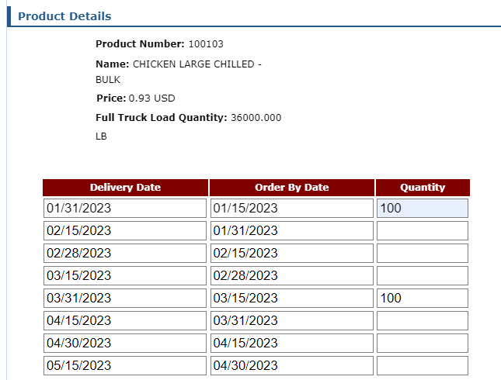
Processing via Extended Search
Quantity
Add desired Quantity in the field next to the desired Delivery Date/Order By Date pair(s).
Locate specific product by product number.

Slide 40
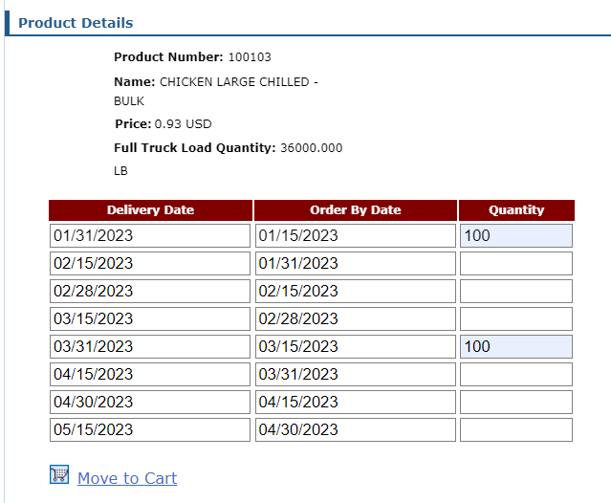
Processing via Extended Search
Click Move to Cart to add selected product quantities
Locate specific product by product number.
Notes:
Review information on slide with RAs

Slide 41
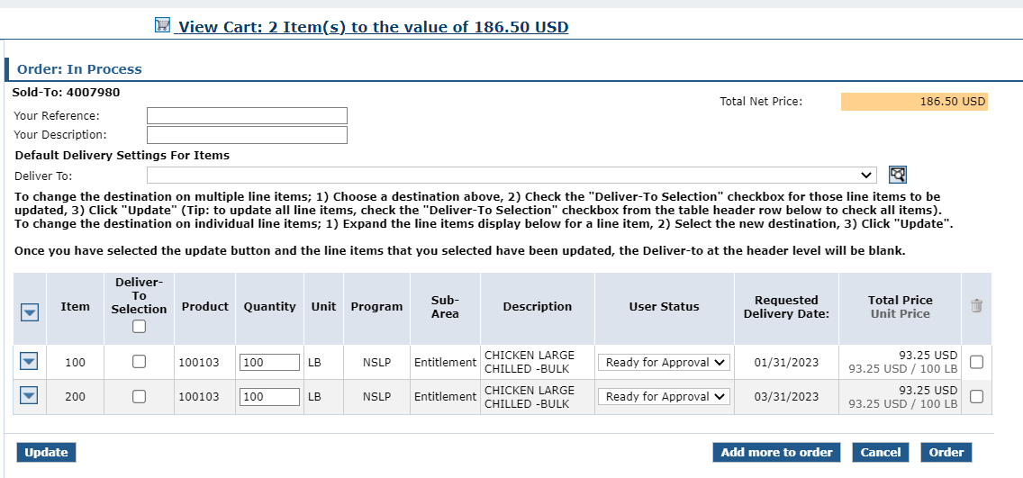
Processing via Extended Search
Portal returns to Domestic Ordering Screen
View Cart summarizes items added
Locate specific product by product number.
Notes:
(Note) A summary at the top of the screen displays the number and total value of products contained in the shopping cart.

Slide 42
Limited Delivery Date Items
Limited Delivery Dates May Appear For Some Processing Products
Follow Guidance For These Products In The Next Slides
Browse catalog for available products.
Notes:
USDA may provide limited delivery dates for some products due to procurement.
Guidance and example for how to request commodity with limited delivery dates is provided on the next slides

Slide 43
Limited Delivery Date Items
Some - not all - processing products have limited delivery dates shown (due to USDA procurement)
Limited
Typical
Browse catalog for available products.
Notes:
EXAMPLE: Product Number 100113 lists limited range of delivery period dates in comparison to the typical 12-month range.
Note the limited dates list 04/01/24-06/30/21
The next slides will provide guidance on how to request quantities for the limited dates.

Slide 44
Limited Delivery Date Items
FOR THESE LIMITED DATE ITEMS ONLY:​
Enter total volume of pounds needed for entire school year in first available delivery date
Requests for end products from processor based on RA’s schedule needs remain the same.
100113
LIMITED DELIVERY DATES
Enter total pounds desired for entire school year
Browse catalog for available products.
Notes:
For limited delivery date items ONLY, enter the total volume of pounds needed for the entire school year in the first available delivery date
This WILL NOT change the method in which RAs request their end products from their processors
RAs will continue to request end products from their processors based on their schedule needs

Slide 45
Limited Delivery Date Items
EXAMPLE:
5500 pounds desired for entire school year
Number of total pounds will vary based on RA organization size and needs​
100113
LIMITED DELIVERY DATES
Enter total pounds desired for entire school year
5500
Click Move to Cart to add selected product quantities
Browse catalog for available products.
Notes:
Example:
If 5500 pounds of Chicken Legs Chilled-Bulk 100113 are needed for the entire school year, RAs will enter the total amount in the Quantity field for the FIRST delivery period available in the limited range of dates.
Once total pounds are entered, click Move to Cart

Slide 46
Processing via Extended Search
Repeat Extended Search With Other Specific Product Numbers Available for Your Bid-Awarded Processor
Locate specific product by product number.

Slide 47
Domestic Requisition In Progress
Click View Cart link to review request.
Cart will not save if:
system times out
user logs off before clicking Order.
Locate specific product by product number.
Notes:
Once all materials are listed for the desired processor select View Cart to select Ship-To location and save the requisition as a draft.
Remember, RAs will create a new processing request/requisition for each individual processor

Slide 48
Add Descriptive Information
Reference & Description
RAs can add descriptive information to each requisition for easier identification and clarification later in WBSCM.
Notes:
Review information on slide with RAs

Slide 49
Domestic Requisition In Progress
Optional: Complete Your Reference
Your Reference allows further clarification by referring to other relevant information.
Locate specific product by product number.
Notes:
This field is optional but may be helpful for record keeping and tracking

Slide 50
Domestic Requisition In Progress
Optional: Your Description
Your Description is a free text field describing the requisition.
Locate specific product by product number.
Notes:
The Description field is also optional, but may be helpful to determine what products or ship-to locations are found in the specific requisition.
Ex: May list
Commodity groups i.e. chicken, etc.
Processor location, i.e. Tyson, etc.

Slide 51
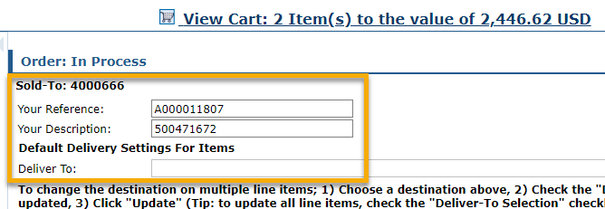
Domestic Requisition In Progress
Example
Your Reference: A000011807
Your Description: 500471672
Locate specific product by product number.
Notes:
Optional fields are alpha-numeric
RAs can use these fields in a way that best works for them and their record keeping and tracking.

Slide 52
Domestic Requisition In Progress
Click Update
Locate specific product by product number.
Notes:
To save updated fields in the Order In Process screen, click update to save new or edited information.

Slide 53
Domestic Requisition In Progress
Oops!
Need to remove an item?
Check the boxes next to materials to remove.
Click update to remove materials.
Locate specific product by product number.
Notes:
To delete an item, first click the checkbox in the trash can icon column for the line item you want to remove
Then click update to remove the materials.

Slide 54
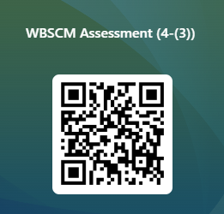
RA-Assessment:
Scan QR Code to access the assessment or click/type in the link below in your browser.
https://forms.office.com/r/MX6gsdAk8c
Notes:
RAs should complete this assessment question as part of required training.
RAs can access the question and select the appropriate response by using devices to access the QR code or by using the link on the slide.

Slide 55
Select Ship-To Destination
Apply All
All line items of goods in the cart will have the same Deliver To/Ship-To location.
Notes:
Each requisition should have material sent to one ship-to location.
This allows RAs to simplify the selection of ship-to locations and allows for a more efficient “check out”.
Example:
Request 1= Location 1: Tyson
Request 2 = Location 2: Land O’ Lakes
Request 3 = Peterson Farms

Slide 56
Deliver To/Ship-To
Click arrow to select Deliver To/Ship-To
Locate specific product by product number.
Notes:
Underneath the reference and description sections, the Deliver To section will be used to select desired Ship-To locations (Processor for Processing Diversion)
Note: Emphasize the importance of slowing down and confirming which Ship-To is desired and selected
Warehouses and processors will all be listed together
Take care that RAs do not click too quickly and choose the location above or below the one desired.

Slide 57
Deliver To/Ship-To Apply All
To apply Deliver To/Ship-To location to all line items, click Deliver To Selection check box in header
Locate specific product by product number.
Notes:
Select the checkbox under the Deliver To Selection header to select all.

Slide 58
Deliver To/Ship-To Apply All
Click Update
Locate specific product by product number.
Notes:
Click update to attach the Processor previously chosen in the Deliver To drop down to all the line items

Slide 59
Update Draft Status
Update To Draft
Update Requisitions to Draft Status to conduct Quality Assurance
Notes:
Best practice: All requisitions will be updated to Draft status to save for Quality Assurance checks before submitting to TDA as Ready for Approval

Slide 60
Update Draft Status
1
Mark requisition as Draft to conduct QA (Quality Assurance Check)
Change “User Status” from “Ready for Approval” to “Draft” status for each line item
Locate specific product by product number.
Notes:
RAs will change the User Status for each line item from Ready for Approval to Draft in order to conduct Quality Checks

Slide 61
Update Draft Status
2
Click dropdown arrow for each item
Click dropdown arrow for each line item to change to “Draft” status
Locate specific product by product number.
Notes:
To change the User Status, Click on the dropdown arrow for each line item.

Slide 62
Update Draft Status
Select “Draft”
3
Select “Draft” from dropdown menu
Locate specific product by product number.
Notes:
Select Draft from the dropdown menu.
Repeat for each line item.

Slide 63
Update Draft Status
4
Confirm User Status for every line item is set to “Draft”
Locate specific product by product number.
Notes:
RAs should double check that each line item in the requisition has been changed to Draft

Slide 64
Update Draft Status
Click Update
5
Click “Update” to save each line-item status as “Draft”
Locate specific product by product number.
Notes:
To save the updates for the User Status, RAs should click Update

Slide 65
Submit Requisition As Draft
Click “Order” to save as Draft
6
*Note:
TDA cannot review requisitions in Draft
Locate specific product by product number.
Notes:
Click “Order” to save the requisition as a draft.
This is NOT an order at this point in the process despite the “Order” button name.
Note*
TDA cannot submit requisitions in Draft Status to USDA
The upcoming slides include:
Best practice process includes RAs conducting Quality Assurance checks for requisitions in Draft Status to minimize errors before submitting as Ready for Approval to TDA
Once quality assurance checks are complete, all requisitions must be updated and marked as Ready for Approval and submitted to TDA

Slide 66
Submit Requisition As Draft
When Requisitions Are in Draft Status:
Requisitions have not been submitted to TDA
TDA cannot order any materials in “Draft”
Total price does count against entitlement balance.
Locate specific product by product number.
Notes:
Note:
When requisitions are submitted/saved as Draft, Entitlement balances will reflect the total price for each request in Draft Status.

Slide 67
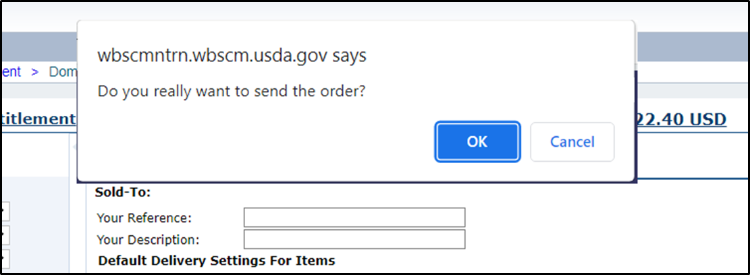
Submit Requisition As Draft
Click OK button in pop-up window to confirm.
7
*Note:
Clicking “OK” saves the requisition as a Draft
Locate specific product by product number.
Notes:
Click Ok to save the request as Draft
TDA does not have the ability to process any requests in Draft Status
RAs should conduct Quality Checks before updating requests to Ready for Approval for TDA review.

Slide 68
Requisition Draft Receipt Confirmation
Confirmation appears
Status marked as Draft
Has not been submitted to TDA
8
9
Requisition # assigned to transaction
10
Locate specific product by product number.
Notes:
Confirmation of Receipt screen includes the User Status listed as Draft

Slide 69
Submit Requisition As Draft
Print to conduct Quality Assurance Review
Click Print
11
Locate specific product by product number.
Notes:
At this point in the process, TDA does not have the ability to submit requisitions marked as Draft to USDA
Quality Assurance Check should be completed by an additional staff member to review and minimize errors before submitting to TDA as Ready for Approval

Slide 70
Quality Assurance Checks
Quality Assurance: Identifying errors before submission
Notes:
Use the Quality Assurance process to review requests and make any corrections needed to Quantities and Delivery locations

Slide 71
Conduct Quality Assurance
1
Select additional staff members to conduct Quality Assurance Checks Use Requisition Checklist for guidance Staff should check requisitions for:
Quantities
Unit of Measure
Ship-To Location
Delivery Dates to selected Ship-To Location
2
3
Locate specific product by product number.
Notes:
Quality Assurance Checks should be conducted by additional staff members prior to submitting requisitions as Ready For Approval to TDA
Quality Assurance Checks can assist in proactively reducing and minimizing errors

Slide 72
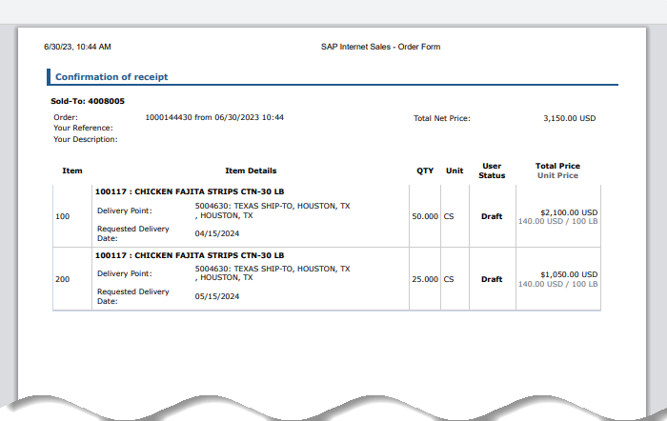
Quality Assurance Check
1
Retrieve the printed PDF for each Direct Delivery Requisition in Draft status.
Follow the steps in the next slides to identify errors
Mark errors on print out to correct in WBSCM later.
Locate specific product by product number.
Notes:
Printed PDFs for each requisition should be given to an additional staff member to review, mark, or edit, before revising (if necessary) requisitions in WBSCM prior to submitting to TDA for approval.

Slide 73
Quality Assurance Check
2
Check material description and product number for each line item
Is this the product you want? If “no”, mark for correction.
Locate specific product by product number.
Notes:
Double check material item to ensure material is correct
If not, mark line item(s) for correction

Slide 74
Quality Assurance Check
3
Check Delivery Point for each line item
Is this the correct processor?
If “no”, mark for correction.
Locate specific product by product number.
Notes:
TRAINER NOTE:
Confirm the correct processor has been selected for desired material
Is this a bid awarded processor?
Does this processor accept this specific material/material code?
If incorrect, mark line item(s) for correction

Slide 75
Quality Assurance Check
Check Unit for each line item
Confirm calculations for QTY use the correct unit of measure for Processing If incorrect, mark for correction and re-calculate QTY.
4
Locate specific product by product number.
Notes:
TRAINER NOTE:
Confirm that QTY of all Processing materials are marked accurately for Unit of Measure.
Some items available for further processing will be in pounds, some will be in cases i.e. Direct Delivery items available or further processing
Qty calculation tools to assist with confirming accurate quantities can include, but not limited to, ProcessorLink, K12Foodservice, Food Buying Guide, etc.
If incorrect, mark for correction.

Slide 76
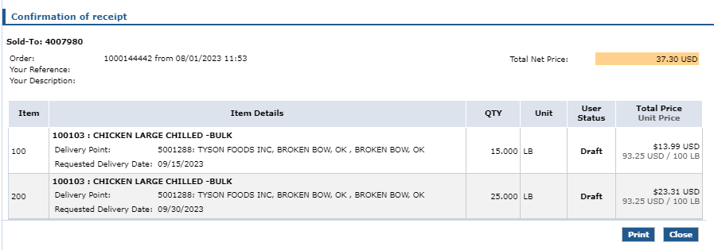
Quality Assurance Check
5
5
Confirm Qty number and Unit of Measure are correct for the Requested Delivery Date to processor If Qty/UoM for Requested Delivery Date not correct, mark for correction
Locate specific product by product number.
Notes:
Confirm quantity of material and UoM for requested delivery date are accurate
If not, mark line item(s) for correction.

Slide 77
Quality Assurance Check
Repeat Quality Assurance Check for:
Each Processing Line Item
Each Processing Requisition
Locate specific product by product number.
Notes:
Review information on slide with RAs

Slide 78
Update Status to Ready for Approval
Update Draft Status to Ready for Approval
Update requisitions to “Ready for Approval” for submission to TDA after Quality Assurance Checks are complete.
Notes:
Once Quality Assurance checks have been conducted for each requisition, log in to WBSCM to update requisitions and submit to TDA as “Ready for Approval”.
Follow the steps in the next slides to update requisitions.

Slide 79
Updating Status to Ready for Approval
Retrieve all Requisition Print Outs used for Quality Assurance checks prior to logging into WBSCM
Locate specific product by product number.
Notes:
Review information on slide with RAs

Slide 80
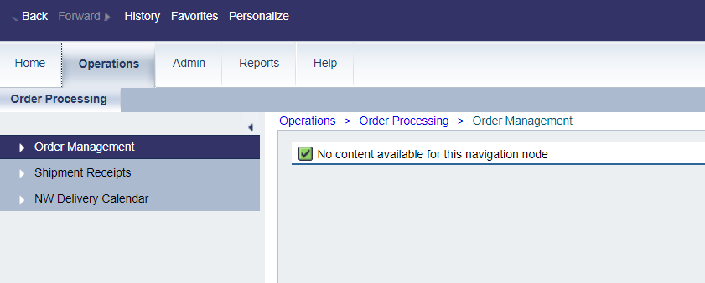
Ready For Approval
Click “Operations”
1
Click Operations Tab to return to requisitions saved in “Draft” Status
Locate specific product by product number.
Notes:
Order Managers will access the Operations tab in WBSCM to update requisitions.

Slide 81
Ready For Approval
2
Click “Order Management”
Click Order Management to search requisitions
Locate specific product by product number.
Notes:
Click Order Management for pathway to retrieve transactions/requisitions saved as draft

Slide 82
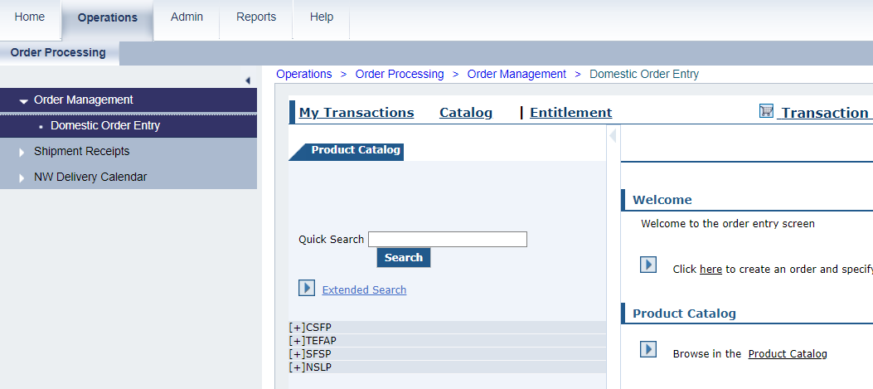
Ready For Approval
Click “My Transactions”
3
Click “My Transactions” to locate saved requisitions in Draft Status
Locate specific product by product number.
Notes:
Click My transactions to locate requisitions saved as draft

Slide 83
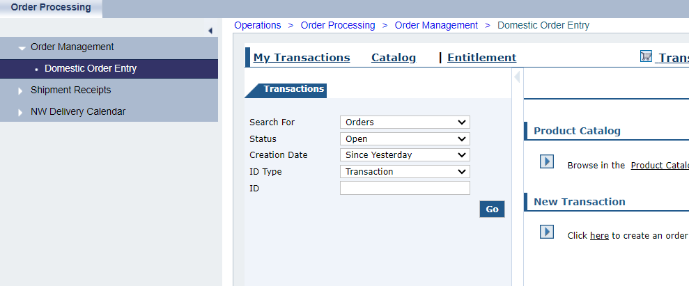
Ready For Approval
Change “Status” and “Creation Date” fields to search for saved requisitions
Locate specific product by product number.
Notes:
Status and Creation Date fields will be changed to locate requisitions

Slide 84
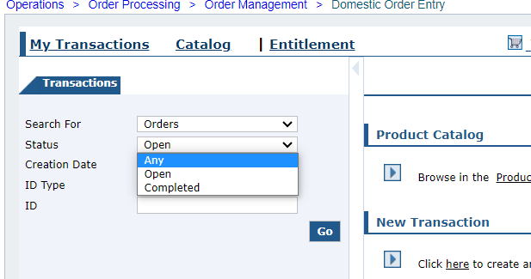
Ready For Approval
4
Click “Status” Dropdown
Click “Status” field dropdown
Change “Status” to “Any”
Locate specific product by product number.
Notes:
Change Status field from Open to Any

Slide 85
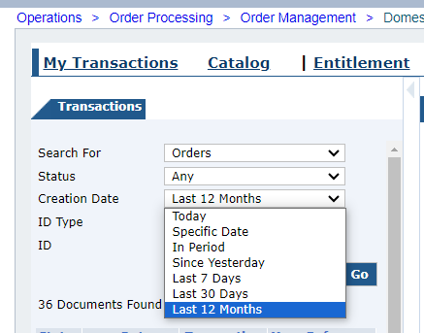
Ready For Approval
Click “Creation Date” field dropdown
Change “Creation Date” to “Last 12 Months”
Click “Creation Date” Dropdown
5
Locate specific product by product number.
Notes:
Change Creation Date to Last 12 months

Slide 86
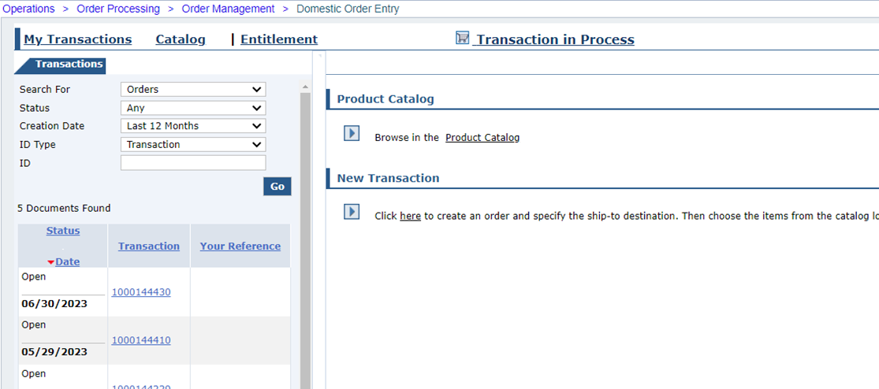
Ready For Approval
Click hyperlinked number in “Transaction” column to view requisition
6
Click hyperlink
Locate specific product by product number.
Notes:
All transactions will be listed.
Click on hyperlink to quickly view each requisition in the main content area screen

Slide 87
Ready For Approval
7
Update all requisitions in “Draft” status
Locate specific product by product number.
Notes:
Selected transactions in the navigation panel will appear in the main content area screen
Review all transactions/requisitions that list Draft as the User Status

Slide 88
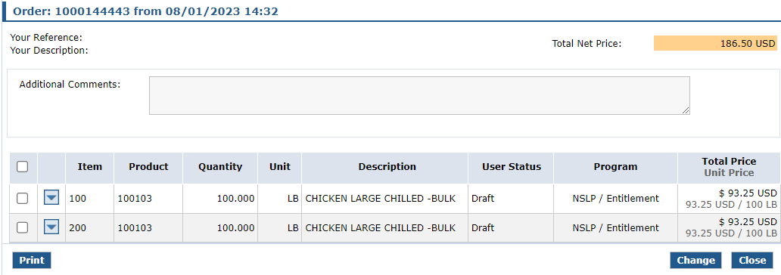
Ready For Approval
To update requisition, click the “Change” button
8
Click
Locate specific product by product number.
Notes:
Use notes from the Quality Assurance checks to make any needed updates.
Click Change to edit the requisition

Slide 89
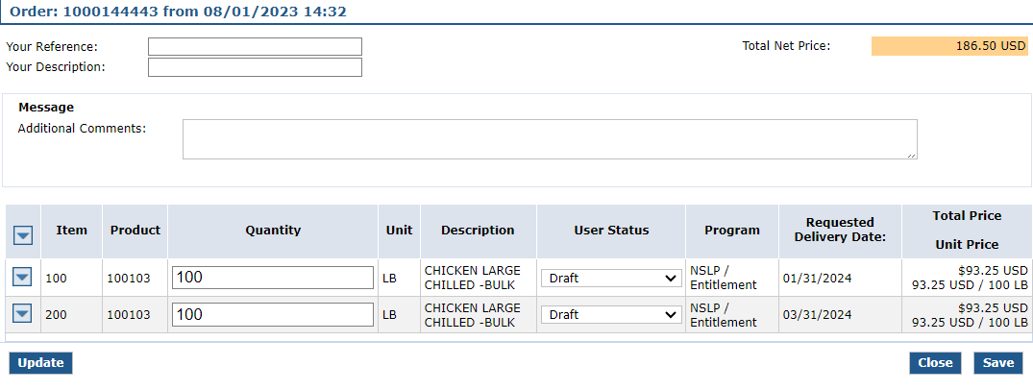
Ready for Approval
To edit Delivery Point click down arrow
“Quantity” and “User Status” fields are now editable
Locate specific product by product number.
Notes:
The following columns/fields become editable:
Delivery Point drop downs (accessed by drop down arrow next to each line item)
Quantity
User Status

Slide 90
Ready for Approval
Edit quantity for line items marked as incorrect on Quality Assurance print outs
If no edits needed, leave quantities as is.
9
Locate specific product by product number.
Notes:
Make any updated to quantities if needed
If not needed, leave these fields as is

Slide 91
Ready for Approval
Click down arrow icon to edit Delivery Points marked as incorrect on Quality Assurance print outs
If no edits needed, leave as is.
Locate specific product by product number.
Notes:
To edit delivery point/processor location, click the down arrow for each line item that needs to be edited
If no delivery point edits are needed, leave as is

Slide 92
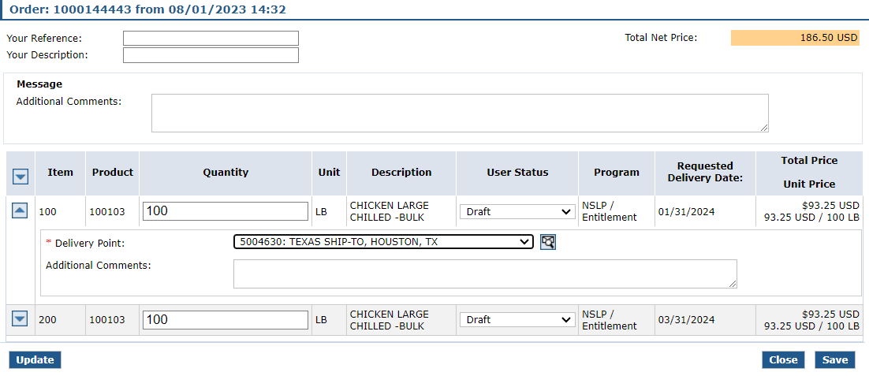
Ready for Approval
To edit Delivery Point, click drop down arrow
*Note:
All warehouses and processors will appear in Delivery Point dropdown
Select the correct processor for Processing items
Locate specific product by product number.
Notes:
When Delivery Point down arrow is clicked, Delivery Point location drop down appears
Click the arrow in the delivery point location fields to select correct processor if corrections are needed

Slide 93
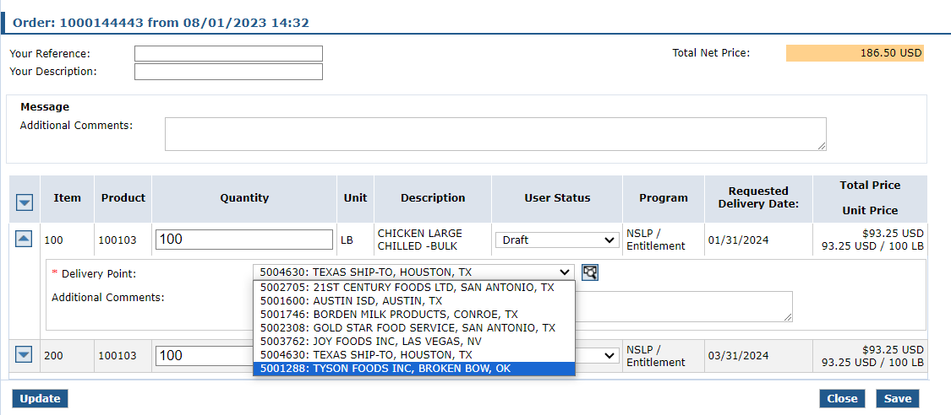
Ready for Approval
*REMINDER:
Select your bid awarded processor for processing items
10
Choose correct processor from dropdown list
Locate specific product by product number.
Notes:
Choose the correct processor if needed
Reminder: Processor for each line item should have an awarded bid AND must accept the product number

Slide 94
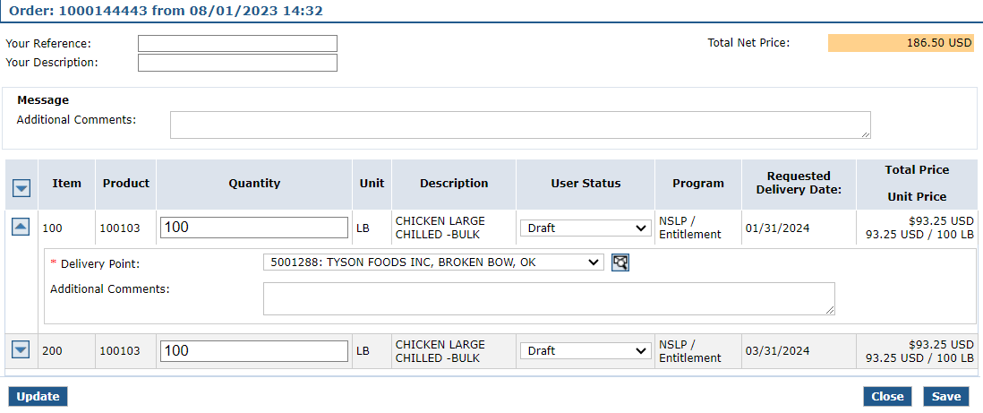
Ready for Approval
11
Click arrow to close Delivery Point dropdown if desired
Locate specific product by product number.
Notes:
If desired, close delivery point section

Slide 95
Ready for Approval
Click “Update” to save changes
Click
12
Locate specific product by product number.
Notes:
Click update to save any edits or changes made to quantities or delivery locations

Slide 96
Ready for Approval
13
Click dropdown in “User Status” column for each line item once all updates are complete
Locate specific product by product number.
Notes:
Once all edits have been made, update the User Status from Draft to Ready for Approval
Note:
*For any line items that need to be removed, RAs will select “Cancel” in the User Status.
All other items remaining in the requisitions should be changed to Ready for Approval

Slide 97
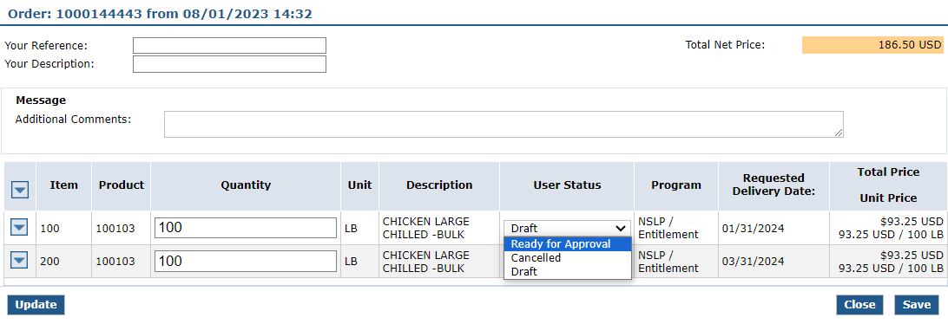
Ready for Approval
14
Select “Ready for Approval” for each line item
Locate specific product by product number.
Notes:
Select Ready for Approval for each line item to be sent to TDA for review

Slide 98
Ready for Approval
15
Click “Update” to save “Ready for Approval” status
Locate specific product by product number.
Notes:
Click update to save User Status changes

Slide 99
Submit Requisition
16
Click “Save” to submit to TDA for review
Click
Locate specific product by product number.
Notes:
Click Save to submit to TDA for review

Slide 100
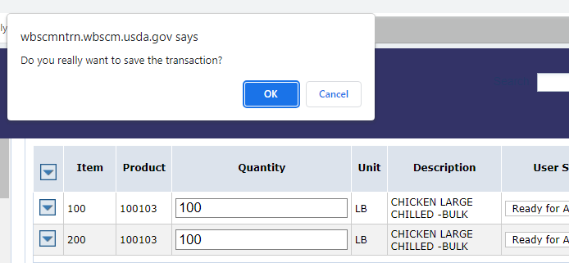
Submit Requisition
17
Click “OK” at top of screen to submit to TDA for review
Click
Locate specific product by product number.
Notes:
Click OK to confirm

Slide 101
Requisition Receipt Confirmation
Requisition Number displayed at top of screen.
Locate specific product by product number.
Notes:
Confirmation of Receipt appears after submitting requisitions

Slide 102
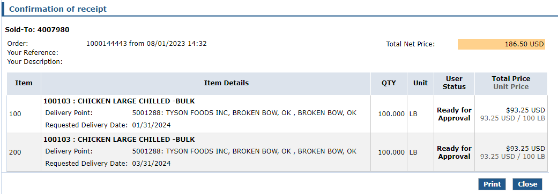
Requisition Receipt Confirmation
Click Print button to print requisition for user's records as appropriate.
Locate specific product by product number.
Notes:
Review information on slide with RAs

Slide 103
Processing via Extended Search
Repeat Extended Search With Other Specific Product Items As Desired
Locate specific product by product number.
Notes:
Review information slide with RAs

Slide 104
Run Entitlement Report
Run the Entitlement Report after submitting each requisition to see Entitlement Balances.
Notes:
Review information on slide with RAs

Slide 105
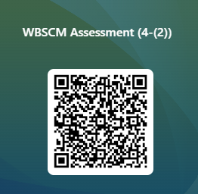
RA-Assessment :
Scan QR Code to access the assessment or click/type in the link below in your browser.
https://forms.office.com/r/3wFdSXiSA6
Notes:
RAs should complete this assessment question as part of required training.
RAs can access the question and select the appropriate response by using devices to access the QR code or by using the link on the slide.

Slide 106
Questions?
Notes:
Collect questions in all training settings to create FAQ for RA103.

Slide 107
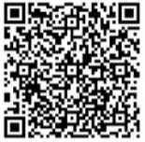
107
Recall, Reflect, and Release
Scan the QR Code to submit your response or click on the link below.
https://bit.ly/3pBXPbE
Notes:
Image: https://i.ytimg.com/vi/kfr4z1M6acg/maxresdefault.jpg

Slide 108
For WBSCM Assistance
See Contact Information Section on WBSCM Transition Page

Slide 109
Lab Time:
Notes:
Allow time for exploration in NTRN, creating mock requisitions, clarifying questions, etc.

Slide 111
Contact Us
https://squaremeals.org/Programs/FDPWBSCMTransitionProject.aspx
Contact Your Education Service Center

